Slide 1


Maede Miri
2023-September
https://github.com/maedemiri/coursera-Space-X

Slide 2

Outline
Executive Summary
Introduction
Methodology
Results
Conclusion
Appendix

Slide 3
Executive Summary
-Summery of methodologies
-Summery of all results
Data collection
Data wrangling
EDA with data visualization
EDA with SQL
Building an interactive map with Folium
Building a dashboard with Ploty Dash
Predictive analysis (Classification)
EDA
Interactive analysis
Predictive analysis

Slide 4
Introduction
-Project background and context
SpaceX advertises Falcon 9 rocket launches on its website with a cost of 62 million dollars; other providers cost upward of 165 million dollars each, much of the savings is due to the fact that SpaceX can reuse the first stage.
-Problems you want to find answers
In this project, we will predict if the Falcon 9 first stage will land successfully.

Slide 5

Section 1

Slide 6
Methodology
-Executive Summary
Data collection methodology:
SpaceX Rest API
Web Scraping from Wikipedia
Perform data wrangling
Using One Hot Encoding techniques for data fields for Machine Learning and data clening of null values and dispensable columns
Perform exploratory data analysis (EDA) using visualization and SQL
Perform interactive visual analytics using Folium and Plotly Dash
Perform predictive analysis using classification models
Linear Regression(LR),K Nearest Neighbor(KNN), Support Vector Machine(SVM) and Decision Tree(DT) models to determine the classifier data and evaluation.

Slide 7
Data Collection
-Describe how data sets were collected.
Collection SpaceX launch data from the SpaceX REST API, this API give us data about launches and information about rocket used, payload, launch speciffications and landing speciffications and landing outcome. API URL: api.spacex.com/v4/
Also, another way for obtaining Falcon 9 launch data is web scraping Wikipedia and using Beautiful Soup.
Ready data for data consolidation and wrangling
Use SpaceX Rest API
Return SpaceX data in Json
Normalize data into csv file
Normalize data into csv file
Extract data by Beautiful Soup
Get HTML Response(from Wikipedia)

Slide 8
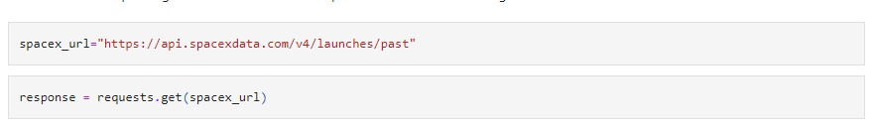
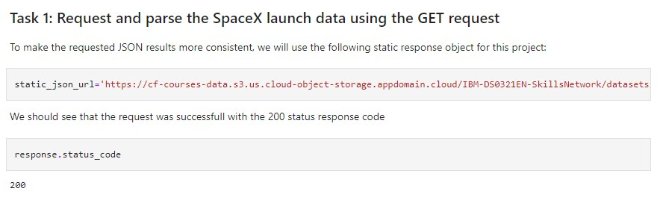
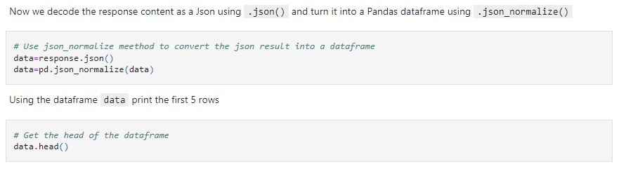
Data Collection – SpaceX API
1
2
3

Slide 9
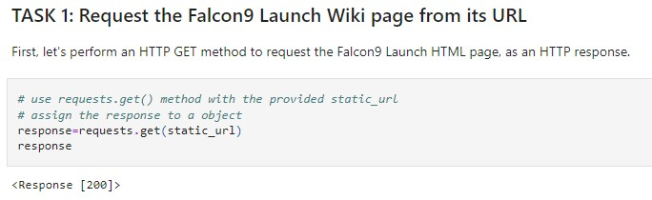
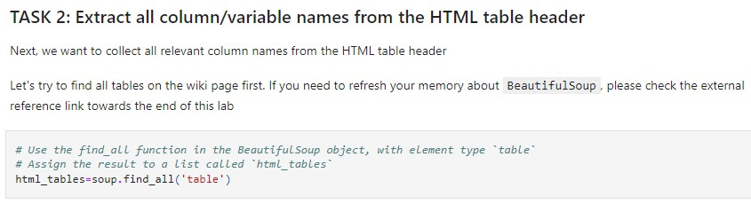
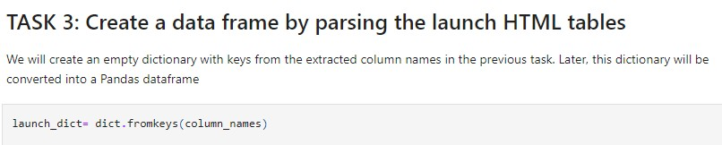
Data Collection - Scraping
1
Using this URL
2
3
4

Slide 10
Data Wrangling
Calculating the non values and the type of each column
Calculating the number of launches on each site
Calculating the number and occurrence of each orbit
Calculating the number and occurence of mission outcome per orbit type
Generating a label for landing outcomes baced on the data in the outcome column
Make a new column(Class) for the labels of outcome column

Slide 11
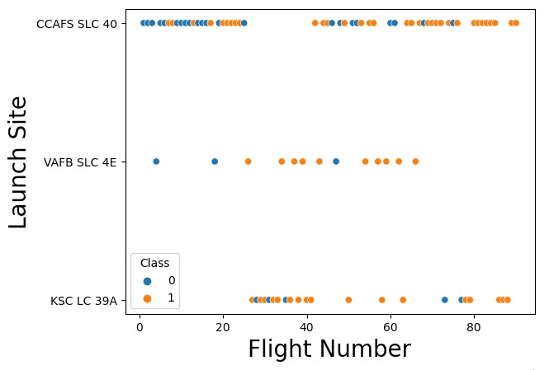
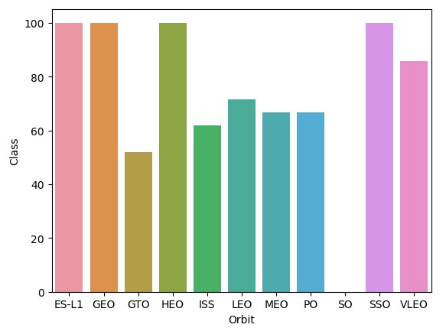
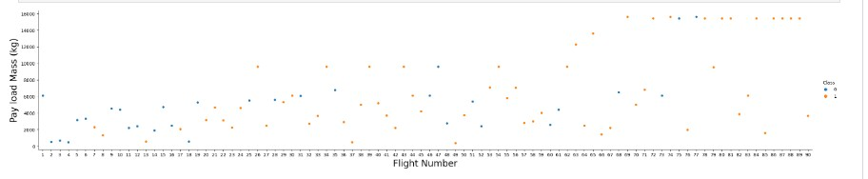
EDA with Data Visualization
To explore data, we used of catplot, scatterplot, and barplot to visualize the relationship between columns and finding the importance of each column.

Slide 12
EDA with SQL
Displaying the names of the unique launch sites in the space mission
Displaying 5 records where launch sites begin with the string 'CCA‘
Displaying the total payload mass carried by boosters launched by NASA (CRS)
Displaying average payload mass carried by booster version F9 v1.1
Listing the date when the first succesful landing outcome in ground pad was achieved
Listing the names of the boosters which have success in drone ship and have payload mass greater than 4000 but less than 6000
Listing the total number of successful and failure mission outcomes
Listing the names of the booster versions which have carried the maximum payload mass
Listing the records which will display the month names, failure landing outcomes in drone ship, booster versions, launch site for the months in year 2015
Ranking the count of landing outcomes (such as Failure (drone ship) or Success (ground pad)) between the date 2010-06-04 and 2017-03-20, in descending order

Slide 13
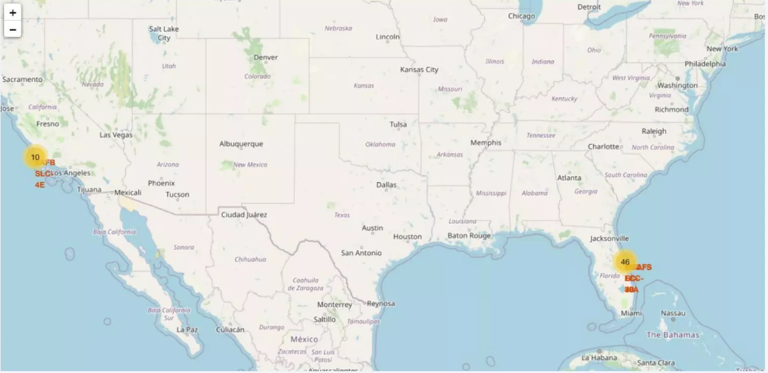
Build an Interactive Map with Folium

Slide 14
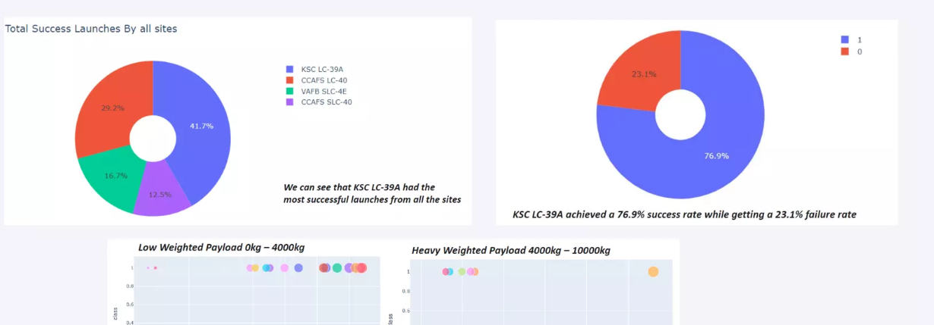
Build a Dashboard with Plotly Dash

Slide 15
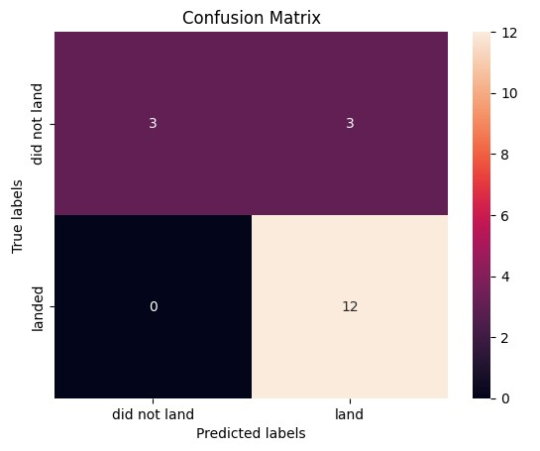

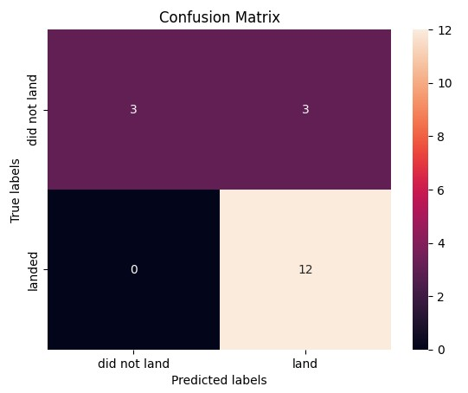
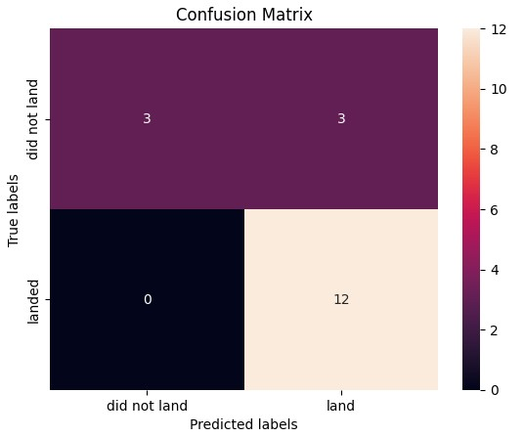
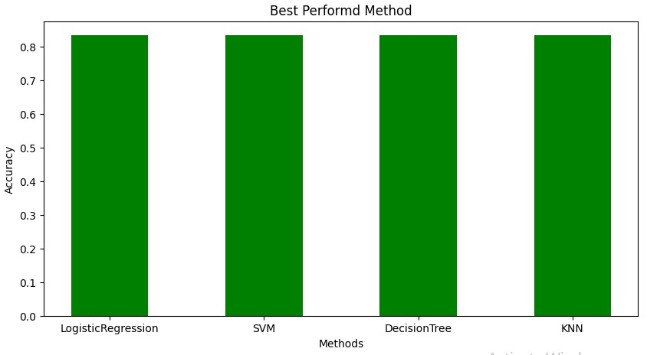
Predictive Analysis (Classification)
All of the models, Logestig Regression, KNN, SVM and Decision Tree gave equal accuracy and it was 83.33%. So it doesn't matter which model we use, They’re similar.

Slide 16
Results
Logistic Regression, KNN ,SVM and Decision Tree models are the best in term of prediction accuracy for this dataset.
Light weight payload perform better than heavier payload.
The success rate of SpaceX launches is directly propotional to the number of years the launches are completed.
Between the launch sites, KSC LC 39A had the most successful launch.
Among all orbits,GEO, SSO, HEO and ES L1 have the best success rate.

Slide 17

Section 2

Slide 18
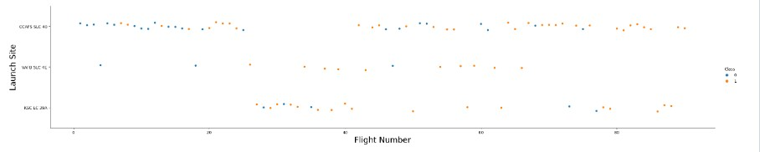
Flight Number vs. Launch Site
Show a scatter plot of Flight Number vs. Launch Site
In this plot we have 3 lanch site in two class(0=Failed(Blue) , 1=Success(Orange))

Slide 19
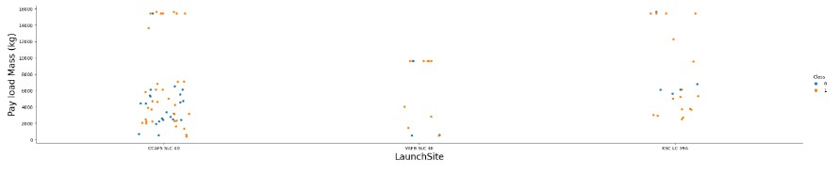
Payload vs. Launch Site
- Show a scatter plot of Payload vs. Launch Site
Inclass(0=Failed(Blue) , 1=Success(Orange)) this plot we have 3 launch site and its payload(continuous variable) in two

Slide 20
Success Rate vs. Orbit Type
Show a bar chart for the success rate of each orbit type
In this plot we show the success rate of each orbit

Slide 21
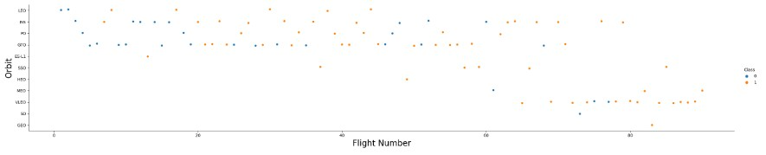
Flight Number vs. Orbit Type
Show a scatter point of Flight number vs. Orbit type
In this plot we show the number of flight for each orbit

Slide 22
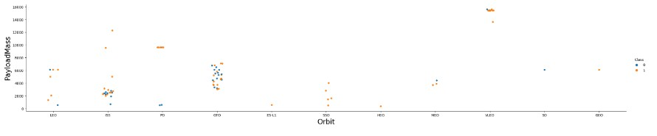
Payload vs. Orbit Type
- Show a scatter point of payload vs. orbit type
In this plot we show the payload of each orbit in two class(0=Failed(Blue) , 1=Success(Orange))

Slide 23
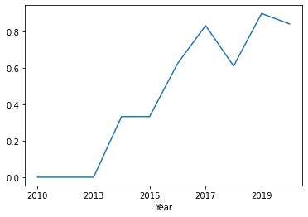
Launch Success Yearly Trend
- Show a line chart of yearly average success rate
In this plot we have the successs rate for each year(2010-2020)

Slide 24
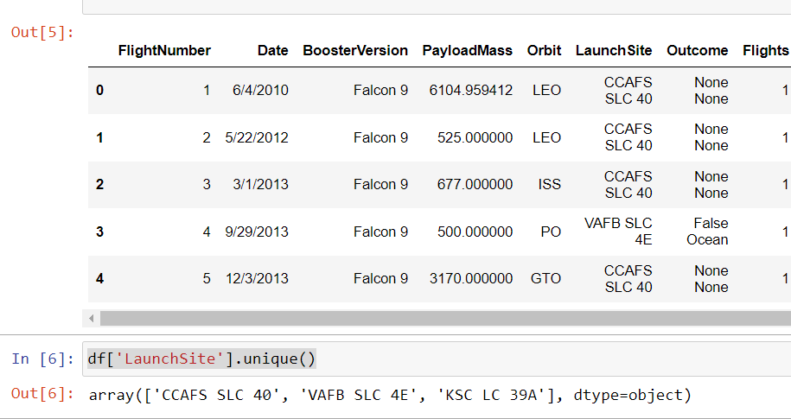
All Launch Site Names
- We have three uniqe launch site

Slide 25
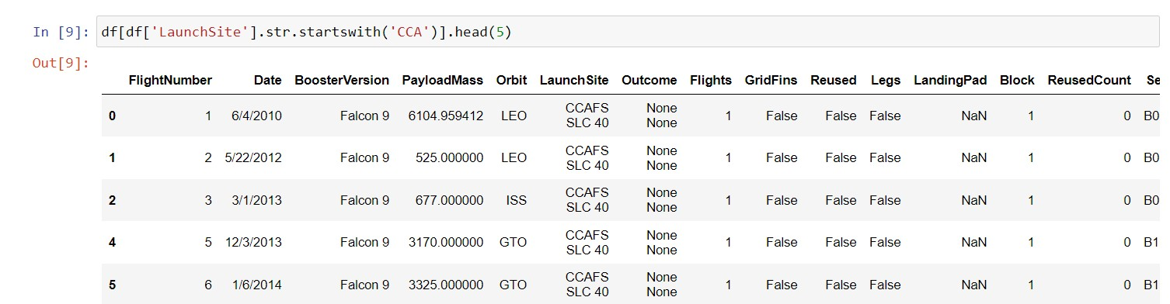
Launch Site Names Begin with 'CCA'
- The following code there are 5 roes of Launch Site column that start with ‘CCA’

Slide 26
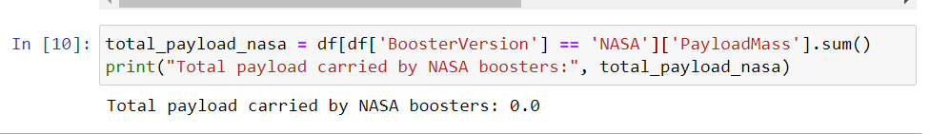
Total Payload Mass
- After using the code below, we understood the total payloadmass carried by boosters from NASA was zero

Slide 27
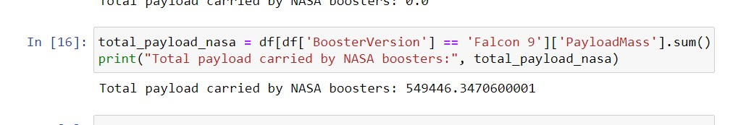
Average Payload Mass by F9 v1.1
Calculate the average payload mass carried by booster version F9 v1.1

Slide 28
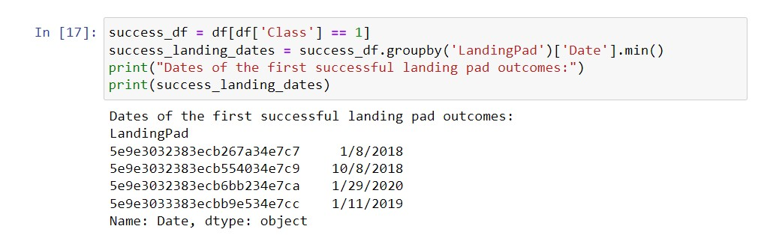
First Successful Ground Landing Date
- The dates of the first successful landing outcome on the groung pad were shown here:

Slide 29
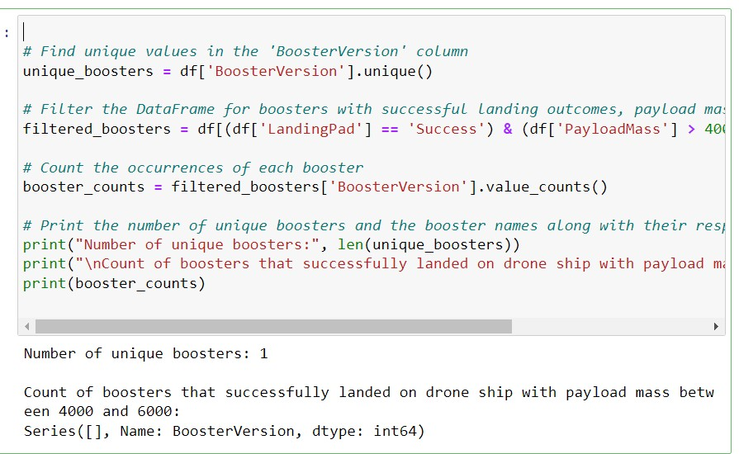
Successful Drone Ship Landing with Payload between 4000 and 6000
- List the names of boosters which have successfully landed on drone ship and had payload mass greater than 4000 but less than 6000

Slide 30
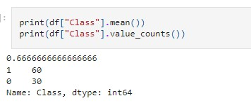
Total Number of Successful and Failure Mission Outcomes
- Here is the total number of successful and failure mission outcomes

Slide 31
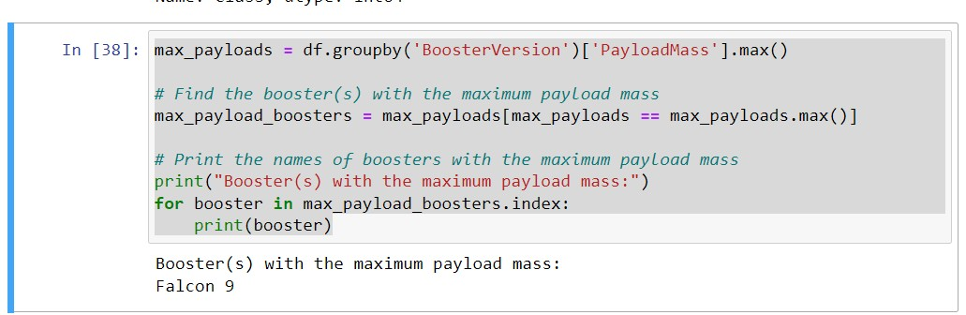
Boosters Carried Maximum Payload

Slide 32
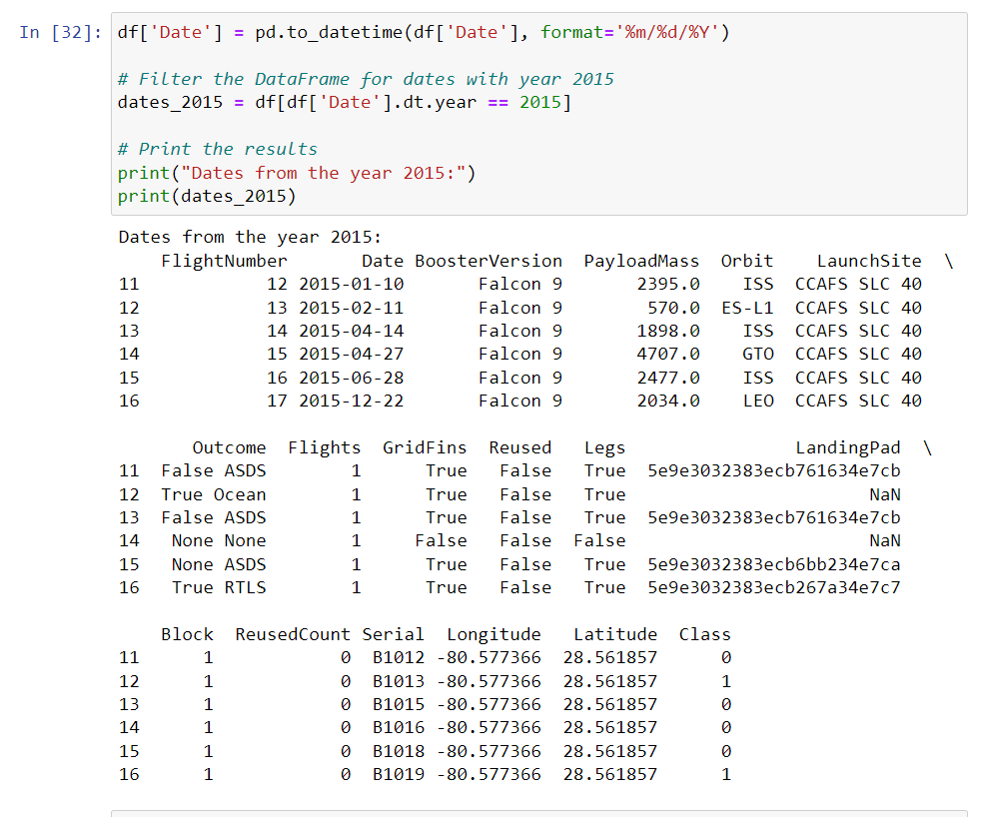
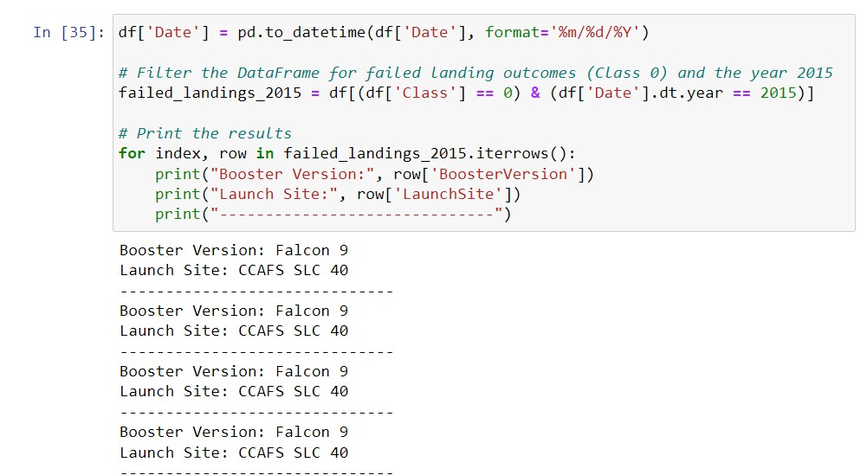
2015 Launch Records
- Here is a List the failed landing outcomes in drone ship, their booster versions, and launch site names for in year 2015

Slide 33
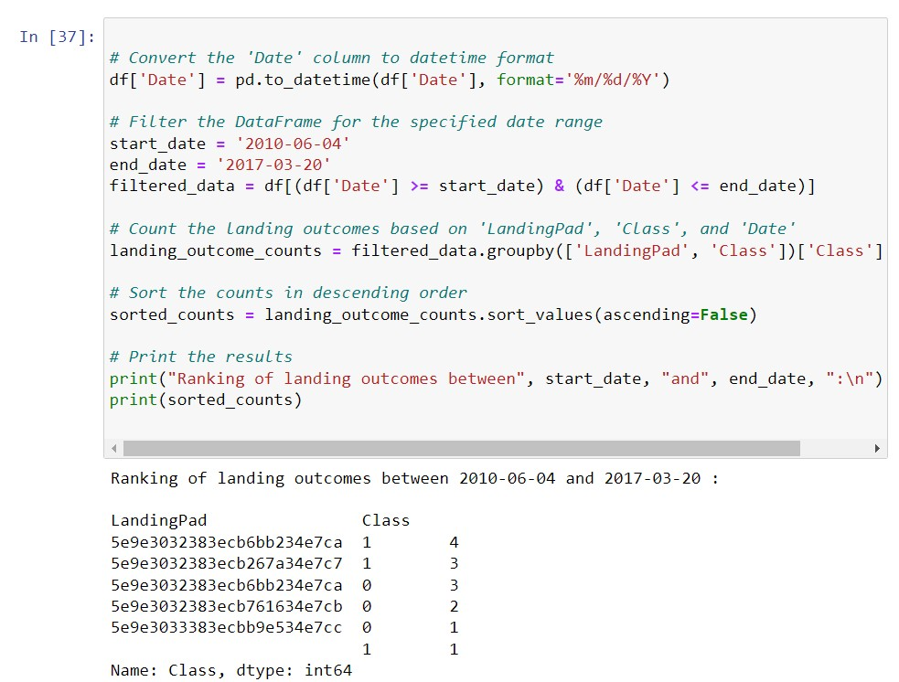
Rank Landing Outcomes Between 2010-06-04 and 2017-03-20
- Here is the rank the count of landing outcomes (such as Failure (drone ship) or Success (ground pad)) between the date 2010-06-04 and 2017-03-20, in descending order

Slide 34

Section 3

Slide 35
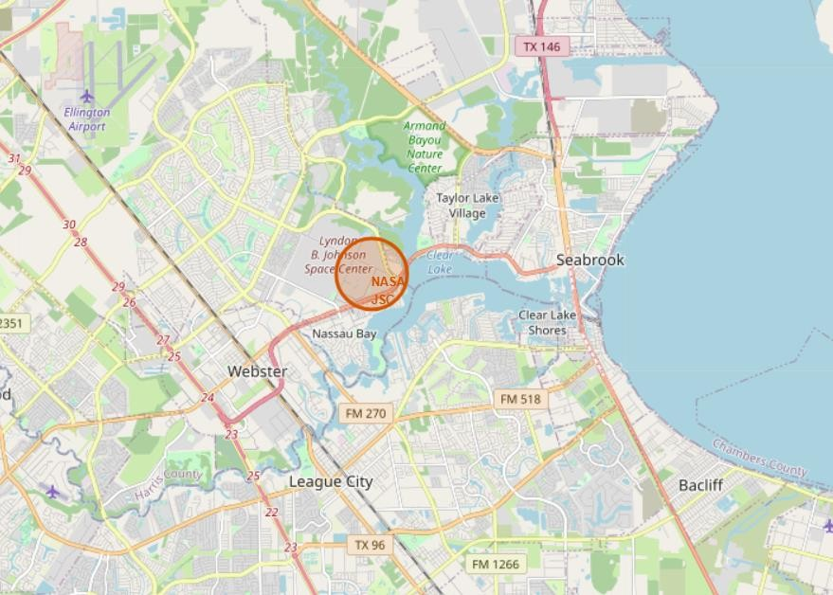
<Folium Map Screenshot 1>

Slide 36
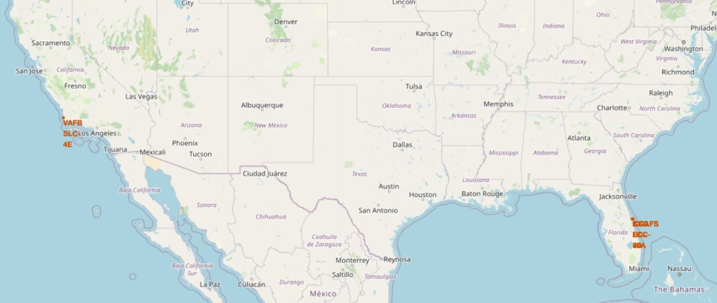
<Folium Map Screenshot 2>

Slide 37

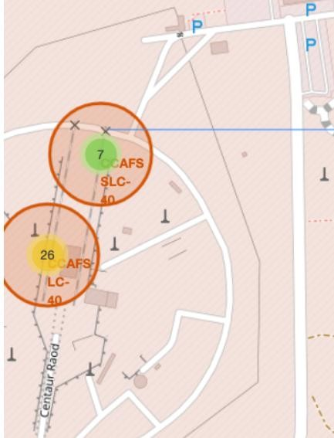
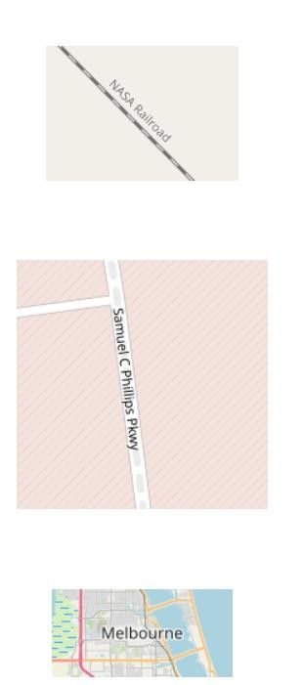
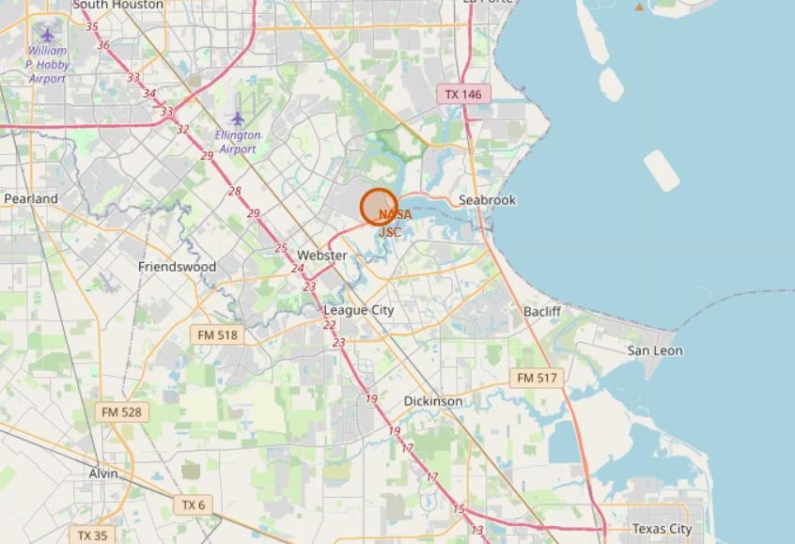
<Folium Map Screenshot 3>

Slide 38

Section 4

Slide 39
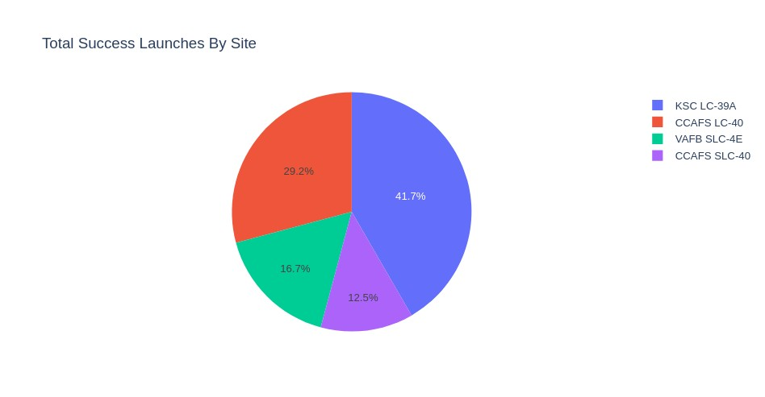
<Dashboard Screenshot 1>
- The place where launchs done successfully is so important and with this plot we can found the best site.

Slide 40
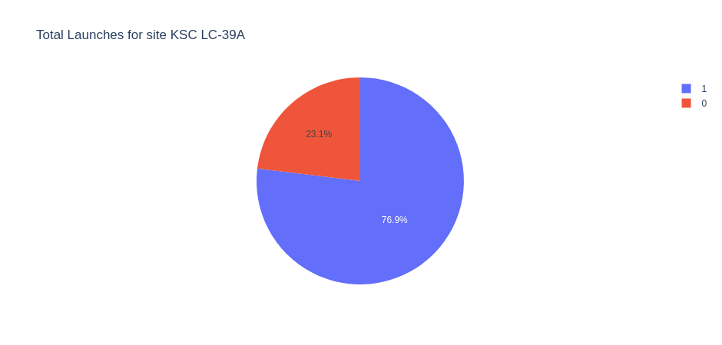
<Dashboard Screenshot 2>
- in this plot we can see the rate of success in KSC LC-39A site

Slide 41
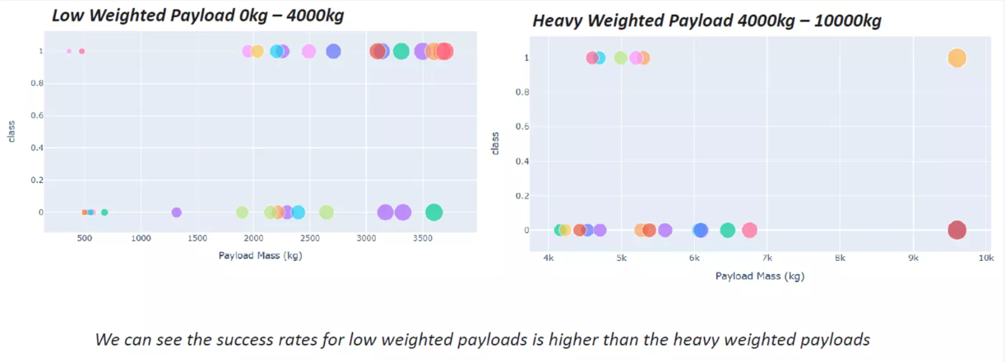
<Dashboard Screenshot 3>

Slide 42

Section 5

Slide 43
Classification Accuracy
- After modeling and using confusion matrix, we see the accuracy rate of all models with GridSearch are equal.

Slide 44
Confusion Matrix

Slide 45
Conclusions
Logistic Regression, KNN ,SVM and Decision Tree models are the best in term of prediction accuracy for this dataset.
Light weight payload perform better than heavier payload.
The success rate of SpaceX launches is directly propotional to the number of years the launches are completed.
Between the launch sites, KSC LC 39A had the most successful launch.
Among all orbits,GEO, SSO, HEO and ES L1 have the best success rate.

Slide 46


